Slide 1

Network+ Guide to Networks 6th Edition
Chapter 8
Wireless Networking

Slide 2
Objectives
Explain how nodes exchange wireless signals
Identify potential obstacles to successful wireless transmission and their repercussions, such as interference and reflection
Understand WLAN (wireless LAN) architecture

Slide 3
Objectives (cont’d.)
Specify the characteristics of popular WLAN transmission methods, including 802.11 a/b/g/n
Install and configure wireless access points and their clients
Describe wireless WAN technologies, including 802.16 (WiMAX), HSPA+, LTE, and satellite communications

Slide 4
The Wireless Spectrum
Continuum of electromagnetic waves
Data, voice communication
Arranged by frequencies
Lowest to highest
Spans 9 KHz and 300 GHz
Wireless services associated with one area
FCC oversees United States frequencies
ITU oversees international frequencies
Air signals propagate across borders

Slide 5
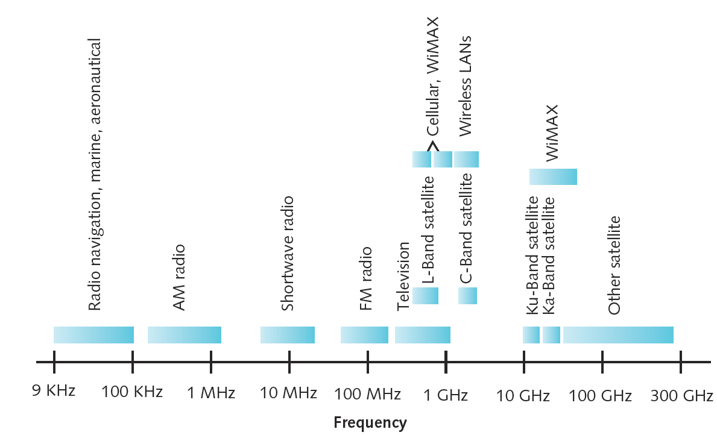
Figure 8-1 The wireless spectrum
Courtesy Course Technology/Cengage Learning

Slide 6
Characteristics of Wireless Transmission
Similarities with wired
Layer 3 and higher protocols
Signal origination
From electrical current, travel along conductor
Differences from wired
Signal transmission
No fixed path, guidance
Antenna
Signal transmission and reception
Same frequency required on each antenna

Slide 7
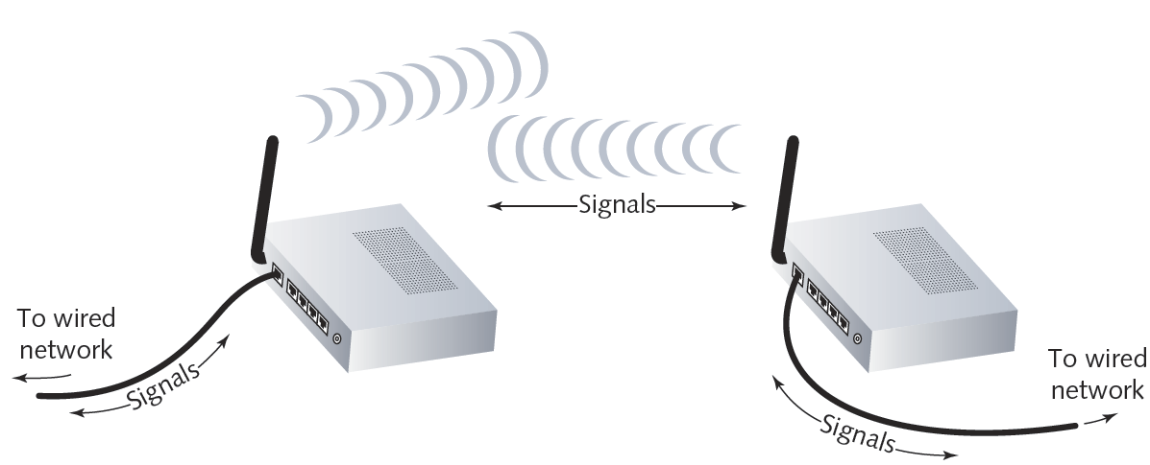
Figure 8-2 Wireless transmission and reception
Courtesy Course Technology/Cengage Learning

Slide 8
Antennas
Radiation pattern
Relative strength over three-dimensional area
Of all electromagnetic energy that antenna sends, receives
Directional antenna
Issues wireless signals along single direction
Omnidirectional antenna
Issues, receives wireless signals
Equal strength, clarity in all directions
Range
Reachable geographical area

Slide 9
Signal Propagation
LOS (line-of-sight)
Signal travels in straight line
Directly from transmitter to receiver
Obstacles affect signal travel; signals may:
Pass through them
Be absorbed into them
Be subject to three phenomena
Reflection: bounce back to source
Diffraction: splits into secondary waves
Scattering: diffusion in multiple different directions

Slide 10
Signal Propagation (cont’d.)
Multipath signals
Wireless signals follow different paths to destination
Caused by reflection, diffraction, scattering
Advantage
Better chance of reaching destination
Disadvantage
Signal delay

Slide 11
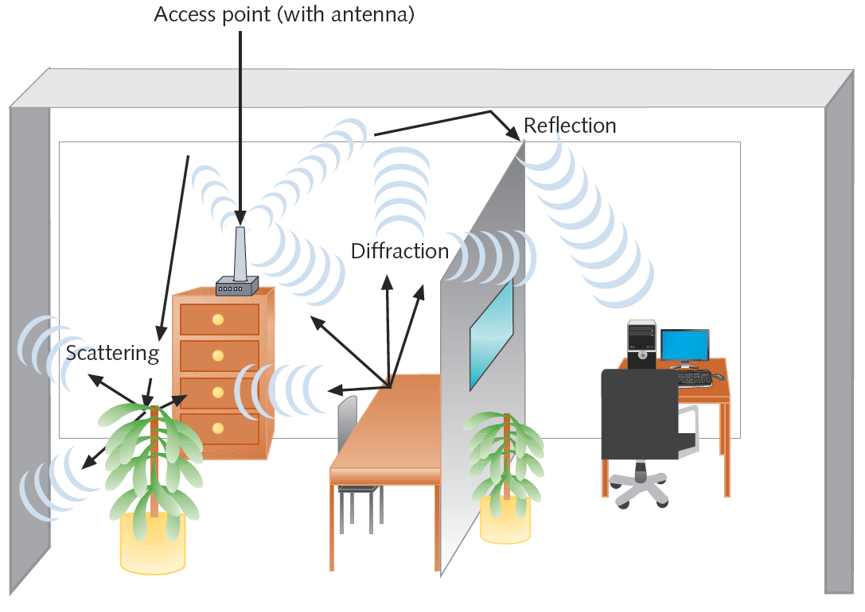
Figure 8-3 Multipath signal propagation
Courtesy Course Technology/Cengage Learning

Slide 12
Signal Degradation
Fading
Variation in signal strength
Electromagnetic energy scattered, reflected, diffracted
Attenuation
Signal weakens
Moving away from transmission antenna
Correcting signal attenuation
Amplify (analog), repeat (digital)
Noise
Significant problem
No wireless conduit, shielding

Slide 13
Frequency Ranges
2.4-GHz band (older)
Frequency range: 2.4–2.4835 GHz
11 unlicensed communications channels
Susceptible to interference
Unlicensed: no FCC registration required
5-GHz band (newer)
Frequency bands
5.1 GHz, 5.3 GHz, 5.4 GHz, 5.8 GHz
24 unlicensed bands, each 20 MHz wide
Used by weather, military radar communications

Slide 14
Narrowband, Broadband, and Spread-Spectrum Signals
Narrowband
Transmitter concentrates signal energy at single frequency, very small frequency range
Broadband
Relatively wide wireless spectrum band
Higher throughputs than narrowband
Spread-spectrum
Multiple frequencies used to transmit signal
Offers security

Slide 15
Narrowband, Broadband, and Spread-Spectrum Signals (cont’d.)
FHSS (frequency hopping spread spectrum)
Signal jumps between several different frequencies within band
Synchronization pattern known only to channel’s receiver, transmitter
DSSS (direct-sequence spread spectrum)
Signal’s bits distributed over entire frequency band at once
Each bit coded
Receiver reassembles original signal upon receiving bits

Slide 16
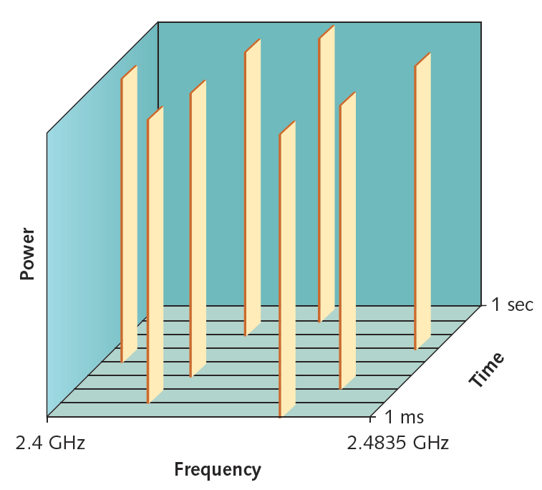
Figure 8-4 FHSS (frequency hopping spread spectrum)
Courtesy Course Technology/Cengage Learning

Slide 17
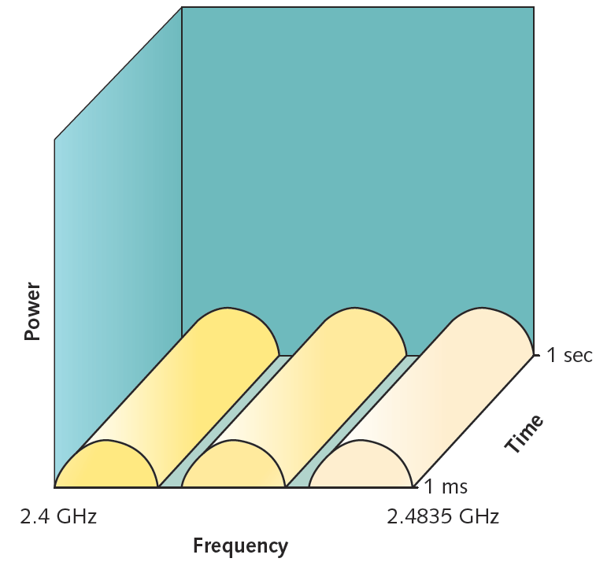
Figure 8-5 DSSS (direct sequence spread spectrum)
Courtesy Course Technology/Cengage Learning

Slide 18
Fixed versus Mobile
Fixed communications wireless systems
Transmitter, receiver locations do not move
Transmitting antenna focuses energy directly toward receiving antenna
Point-to-point link results
Advantage
No wasted energy issuing signals
More energy used for signal itself
Mobile communications wireless systems
Receiver located anywhere within transmitter’s range

Slide 19
WLAN (Wireless LAN) Architecture
Ad hoc WLAN
Wireless nodes transmit directly to each other
Use wireless NICs
No intervening connectivity device
Poor performance
Many spread out users, obstacles block signals
Wireless access point (WAP)
Accepts wireless signals from multiple nodes
Retransmits signals to network
Base stations, wireless routers, wireless gateways

Slide 20
WLAN Architecture (cont’d.)
Infrastructure WLAN
Stations communicate with access point
Not directly with each other
Access point requires sufficient power, strategic placement
WLAN may include several access points
Dependent upon number of stations
Maximum number varies: 10-100

Slide 21
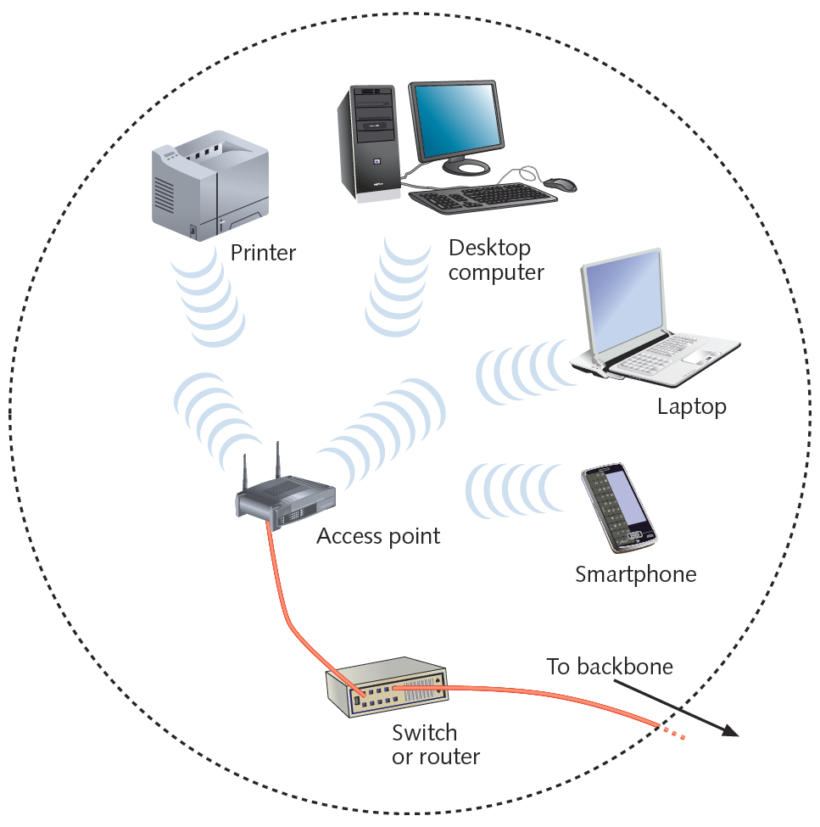
Figure 8-7 An infrastructure WLAN
Courtesy Course Technology/Cengage Learning

Slide 22
WLAN Architecture (cont’d.)
Mobile networking allows roaming wireless nodes
Range dependent upon wireless access method, equipment manufacturer, office environment
Access point range: 300 feet maximum
Can connect two separate LANs
Fixed link, directional antennas between two access points
Allows access points 1000 feet apart
Support for same protocols, operating systems as wired LANs
Ensures compatibility

Slide 23
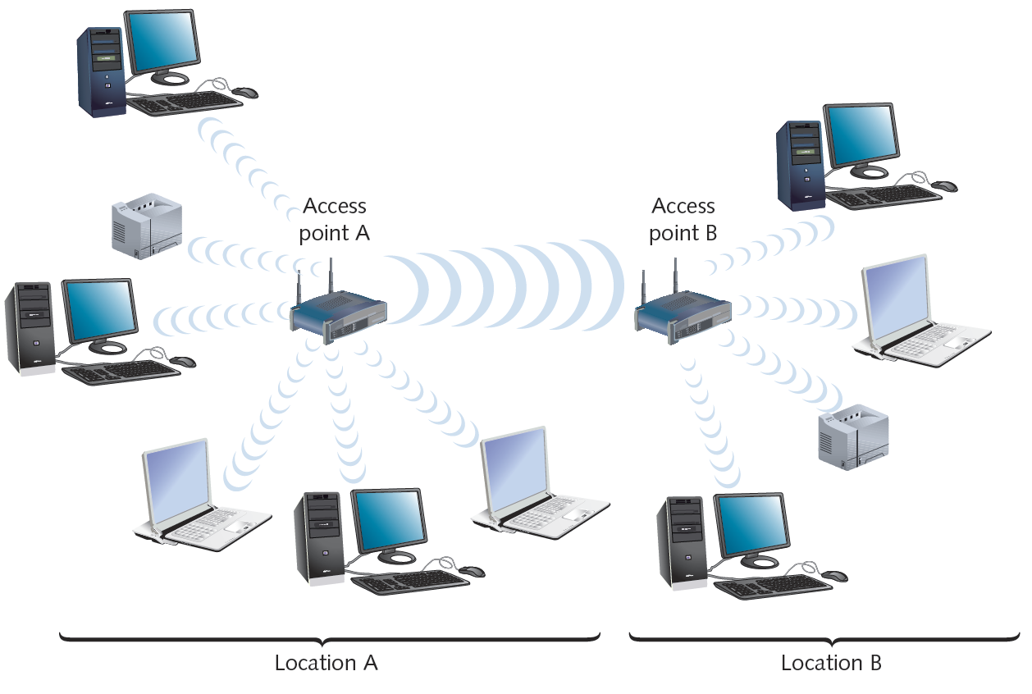
Figure 8-8 Wireless LAN interconnection
Courtesy Course Technology/Cengage Learning

Slide 24
802.11 WLANs
Wireless technology standards
Describe unique functions
Physical and Data Link layers
Differences between standards
Specified signaling methods, geographic ranges, frequency usages
Most popular: developed by IEEE’s 802.11 committee
Notable Wi-Fi standards
802.11b, 802.11a, 802.11g, 802.11n
Share characteristics
Half-duplexing, access method

Slide 25
Access Method
802.11 MAC services
Append 48-bit (6-byte) physical addresses to frame
Identifies source, destination
Same physical addressing scheme as 802.3
Allows easy combination
Wireless devices
Not designed to simultaneously transmit and receive
Cannot quickly detect collisions
Use different access method

Slide 26
Access Method (cont’d.)
CSMA/CA (Carrier Sense Multiple Access with Collision Avoidance)
Minimizes collision potential
Uses ACK packets to verify every transmission
Requires more overhead than 802.3
Real throughput less than theoretical maximum
RTS/CTS (Request to Send/Clear to Send) protocol
Optional
Ensures packets not inhibited by other transmissions
Efficient for large transmission packets
Further decreases overall 802.11 efficiency

Slide 27
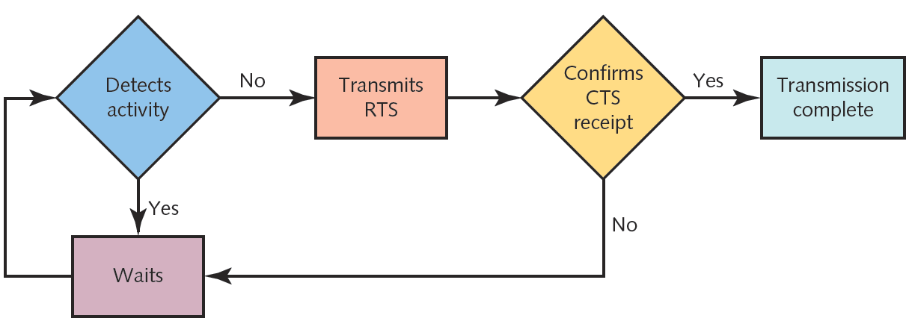
Figure 8-9 CSMA/CA (Carrier Sense Multiple Access with Collision Avoidance
Courtesy Course Technology/Cengage Learning

Slide 28
Association
Packet exchanged between computer and access point
Gain Internet access
Scanning
Surveys surroundings for access point
Active scanning transmits special frame
Probe
Passive scanning listens for special signal
Beacon fame

Slide 29
Association (cont’d.)
SSID (service set identifier)
Unique character string identifying access point
In beacon frame information
Configured in access point
Better security, easier network management
BSS (basic service set)
Station groups sharing access point
BSSID (basic service set identifier)
Station group identifier

Slide 30
Association (cont’d.)
ESS (extended service set)
Access point group connecting same LAN
Share ESSID (extended service set identifier)
Allows roaming
Station moving from one BSS to another without losing connectivity
Several access points detected
Select strongest signal, lowest error rate
Poses security risk
Powerful, rogue access point

Slide 31
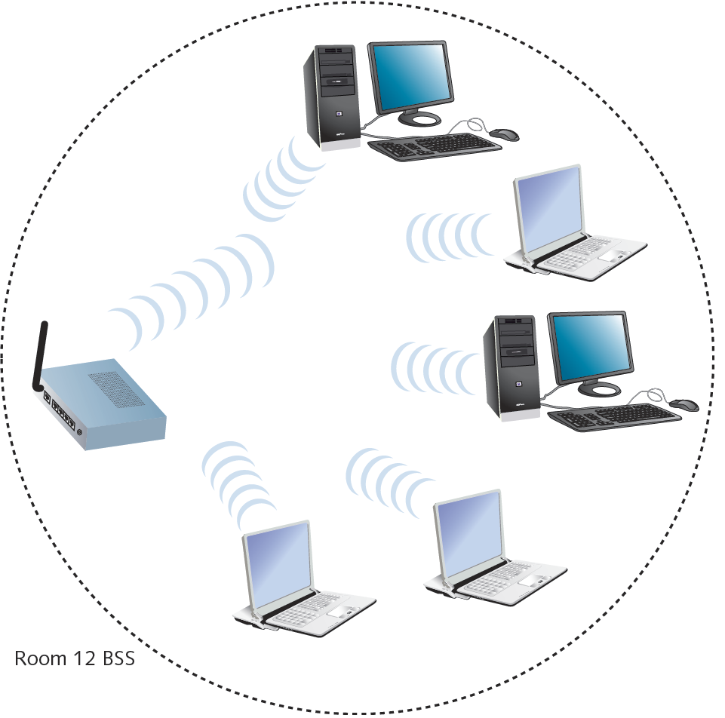
Figure 8-10 A network with a single BSS
Courtesy Course Technology/Cengage Learning

Slide 32
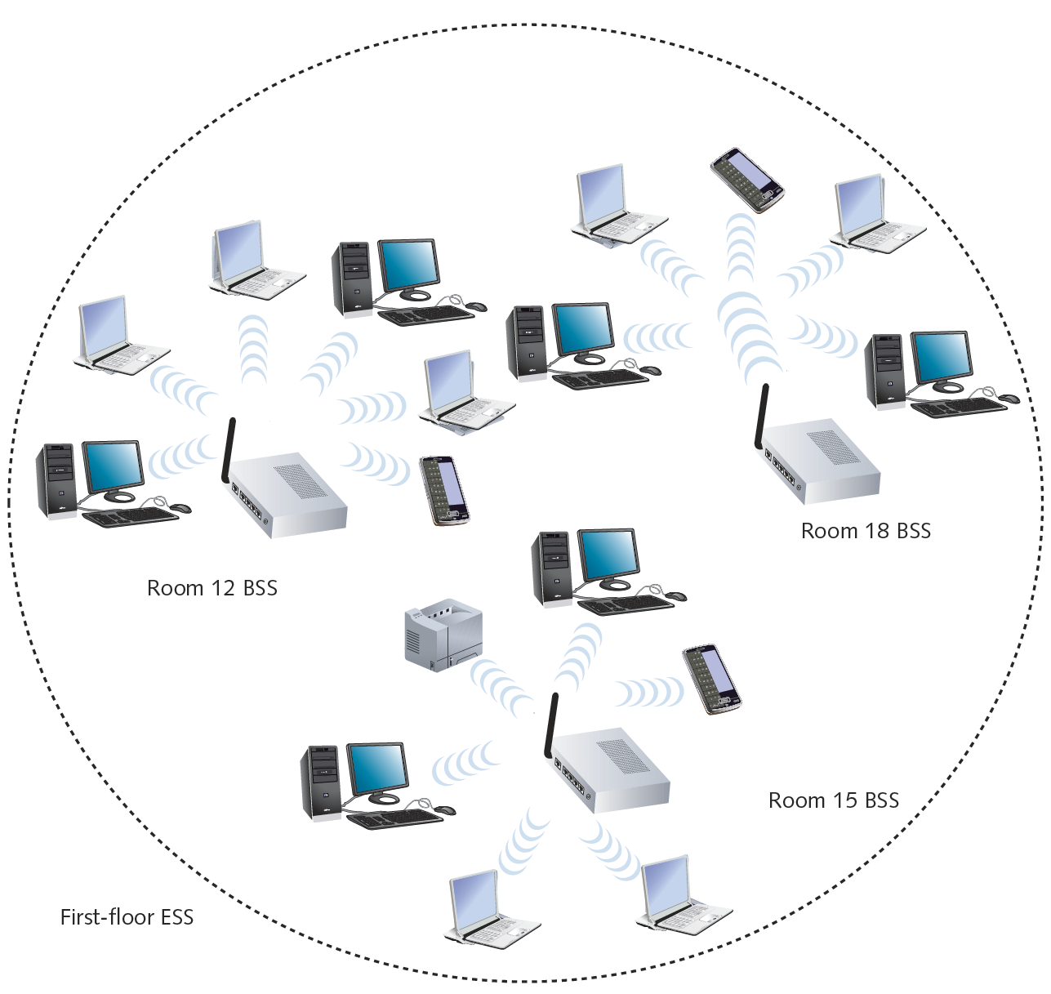
Figure 8-11 A network with multiple BSSs forming an ESS
Courtesy Course Technology/Cengage Learning

Slide 33
Association (cont’d.)
ESS with several authorized access points
Must allow station association with any access point
While maintaining network connectivity
Reassociation
Mobile user moves from one access point’s range into another’s range
Occurs by simply moving; high error rate
Stations’ scanning feature
Used to automatically balance transmission loads
Between access points

Slide 34
Frames
802.11 networks overhead
ACKs, probes, and beacons
802.11 specifies MAC sublayer frame type
Multiple frame type groups
Control: medium access and data delivery
ACK and RTS/CTS frames
Management: association and reassociation
Data: carry data sent between stations

Slide 35
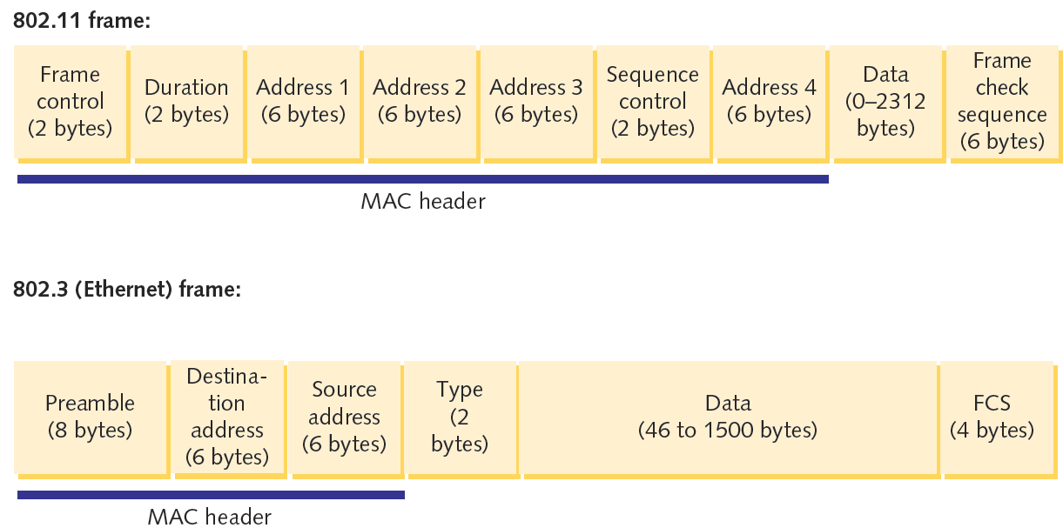
Figure 8-12 Basic 802.11 data frame compared with an 802.3 (Ethernet) frame
Courtesy Course Technology/Cengage Learning

Slide 36
Frames (cont’d.)
802.11 data frame overhead
Four address fields
Source address, transmitter address, receiver address, and destination address
Sequence Control field
How large packet fragmented
Frame Control field
Wi-Fi share MAC sublayer characteristics
Wi-Fi differ in modulation methods, frequency usage, and range

Slide 37
802.11b
2.4-GHz band
Separated into 22-MHz channels
Throughput
11-Mbps theoretical
5-Mbps actual
100 meters node limit
Oldest, least expensive
Being replaced by 802.11g

Slide 38
802.11a
Released after 802.11b
5-GHz band
Not congested like 2.4-GHz band
Lower interference, requires more transmit power
Throughput
54 Mbps theoretical
11 and 18 Mbps effective
20 meter node limit
Requires additional access points
Rarely preferred

Slide 39
802.11g
Affordable as 802.11b
Throughput
54 Mbps theoretical
20 to 25 Mbps effective
100 meter node range
2.4-GHz frequency band
Compatible with 802.11b networks

Slide 40
802.11n
Standard ratified in 2009
Primary goal
Wireless standard providing much higher effective throughput
Maximum throughput: 600 Mbps
Threat to Fast Ethernet
Backward compatible with 802.11a, b, g standards

Slide 41
802.11n (cont’d.)
2.4-GHz or 5-GHz frequency range
Compared with 802.11a, 802.11g
Same data modulation techniques
Compared with three 802.11 standards
Manages frames, channels, and encoding differently
Allows high throughput

Slide 42
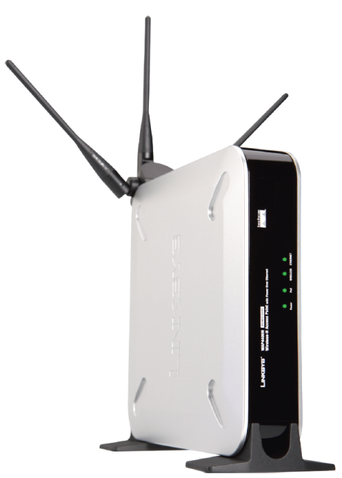
802.11n (cont’d.)
MIMO (multiple input-multiple output)
Multiple access point antennas may issue signal to one or more receivers
Increases network’s throughput, access point’s range
Figure 8-13 802.11n access point with three antennas
Courtesy Cisco Systems, Inc.

Slide 43
802.11n (cont’d.)
Channel bonding
Two adjacent 20-MHz channels bonded to make 40-MHz channel
Doubles the bandwidth available in single 20-MHz channel
Bandwidth reserved as buffers assigned to carry data
Higher modulation rates
Single channel subdivided into multiple, smaller channels
More efficient use of smaller channels
Different encoding methods

Slide 44

802.11n (cont’d.)
Frame aggregation
Combine multiple frames into one larger frame
Advantage: reduces overhead
Figure 8-15 Aggregated 802.11n frame
Courtesy Course Technology/Cengage Learning

Slide 45
802.11n (cont’d.)
Maximum throughput dependencies
Number and type of strategies used
2.4-GHz or 5-GHz band
Actual throughput: 65 to 600 Mbps
Backward compatible
Not all 802.11n features work
Recommendation
Use 802.11n-compatible devices

Slide 46
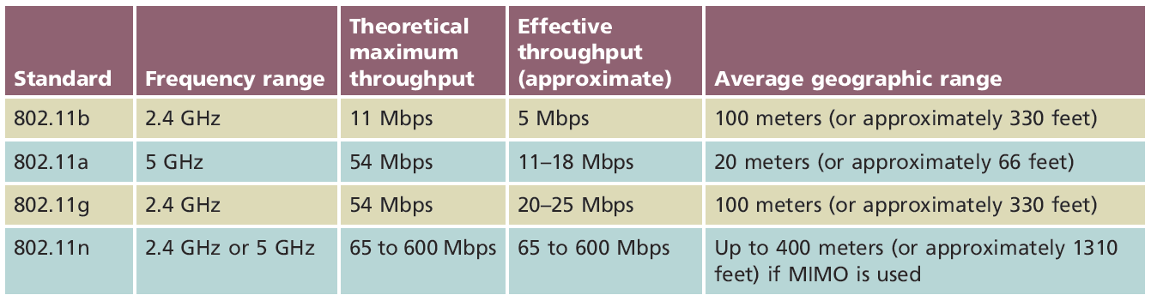
Table 8-1 Wireless standards
Courtesy Course Technology/Cengage Learning

Slide 47
Implementing a WLAN
Designing a small WLAN
Home, small office
Formation of larger, enterprise-wide WANs
Installing and configuring access points and clients
Implementation pitfalls

Slide 48
Determining the Design
One access point
Combine with switching, routing functions
Connects wireless clients to LAN
Acts as Internet gateway
Access point WLAN placement considerations
Typical distances between access point and client
Obstacles
Type and number of, between access point and clients

Slide 49
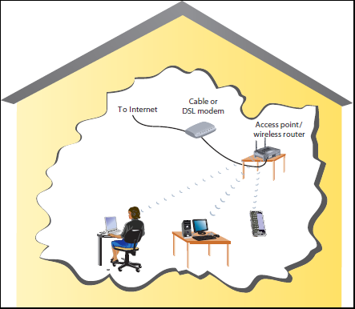
Figure 8-16 Home or small office WLAN arrangement
Courtesy Course Technology/Cengage Learning

Slide 50
Determining the Design (cont’d.)
Larger WLANs
Systematic approach to access point placement
Site survey
Assesses client requirements, facility characteristics, coverage areas
Determines access point arrangement ensuring reliable wireless connectivity
Within given area
Proposes access point testing
Test wireless access from farthest corners

Slide 51
Determining the Design (cont’d.)
Install access points
Must belong to same ESS, share ESSID
Enterprise-wide WLAN design considerations
How wireless LAN portions will integrate with wired portions

Slide 52
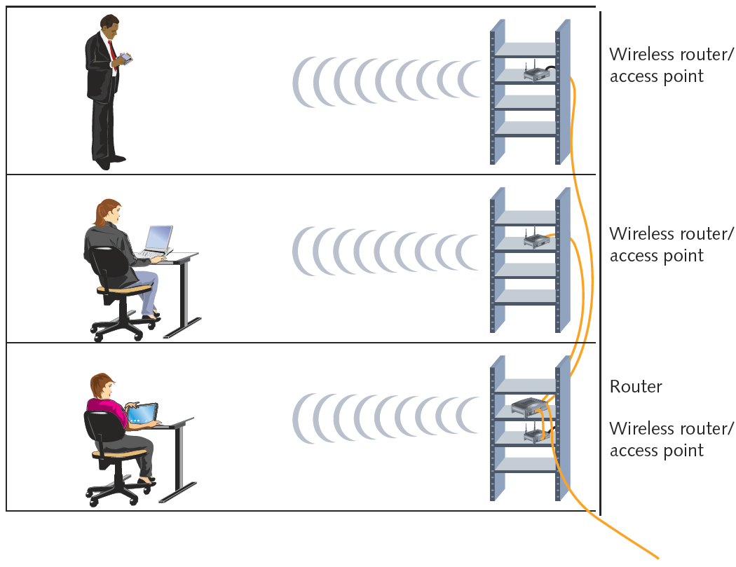
Figure 8-17 Enterprise-wide WLAN
Courtesy Course Technology/Cengage Learning

Slide 53
Configuring Wireless Connectivity Devices
Access point CD-ROM or DVD
Guides through setup process
Variables set during installation
Administrator password
SSID
Whether or not DHCP is used
Whether or not the SSID is broadcast
Security options

Slide 54
Configuring Wireless Clients
Configuration varies from one client type to another
Linux and UNIX clients wireless interface configuration
Use graphical interface
iwconfig command-line function
View, set wireless interface parameters

Slide 55
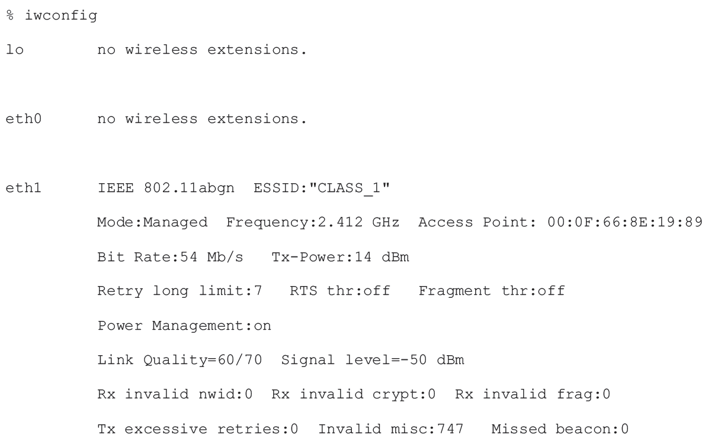
Figure 8-18 Output from iwconfig command
Courtesy Course Technology/Cengage Learning

Slide 56
Avoiding Pitfalls
Access point versus client configurations
SSID mismatch
Incorrect encryption
Incorrect channel, frequency
Standard mismatch (802.11 a/b/g/n)
Incorrect antenna placement
Verify client within 330 feet
Interference
Check for EMI sources

Slide 57
Wireless WANs
Wireless broadband
Latest wireless WAN technologies
Specifically designed for:
High-throughput; long-distance digital data exchange

Slide 58
802.16 (WiMAX)
WiMAX (Worldwide Interoperability for Microwave Access)
Most popular version: 802.16e (2005)
Improved WiMAX version: 802.16m (2011)
Functions in 2-11 or 11-66 GHz range
Licensed or nonlicensed frequencies
Ability to transmit and receive signals up to 30 miles
With fixed antennas
About 10 miles when antennas are mobile

Slide 59
802.16 (WiMAX) (cont’d.)
802.16m
Positioned to compete favorably with cellular data services
Backwards compatible with 802.16e equipment
Maximum throughput
Downlink: 120Mbps
Uplink: 60Mbps
Future improvements could take to 1Gbps

Slide 60
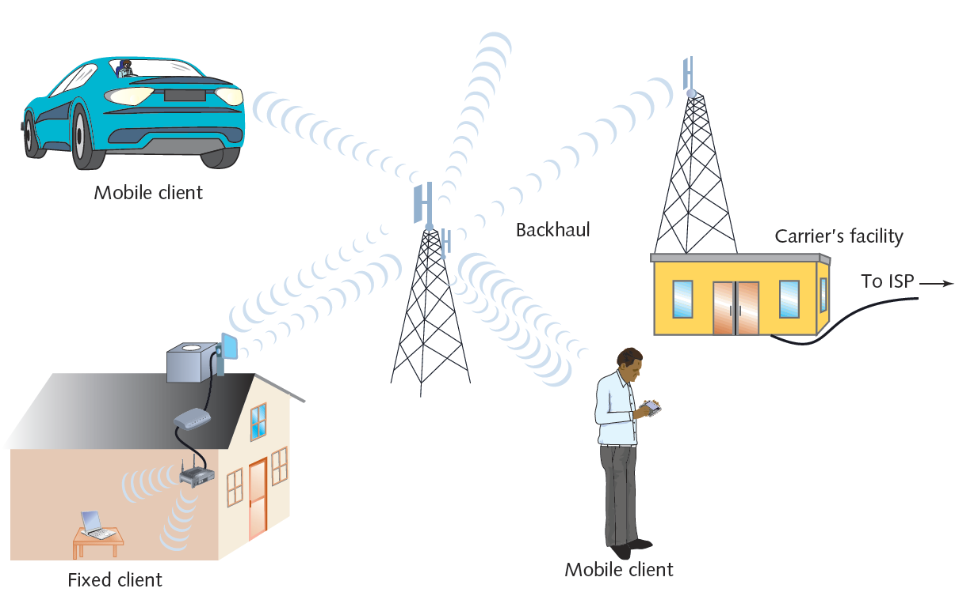
Figure 8-19 WiMAX network
Courtesy Course Technology/Cengage Learning

Slide 61
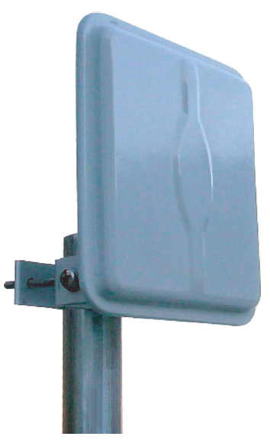
Figure 8-20 WiMAX residential antenna
Courtesy of Laird Technologies

Slide 62
Cellular
Initially designed for analog telephone service
Today deliver data and voice
Cellular technology generations
1G: analog
2G: digital transmission up to 240Kbps
3G: data rates up to 384Kbps
Data communications use packet switching
4G: all-IP, packet switched network for data and voice

Slide 63
Cellular (cont’d.)
Network infrastructure
Cells served by antenna and base station
Controller assigns mobile clients frequencies
Cell size depends on:
Network’s access method
Region topology
Population
Amount of cellular traffic

Slide 64
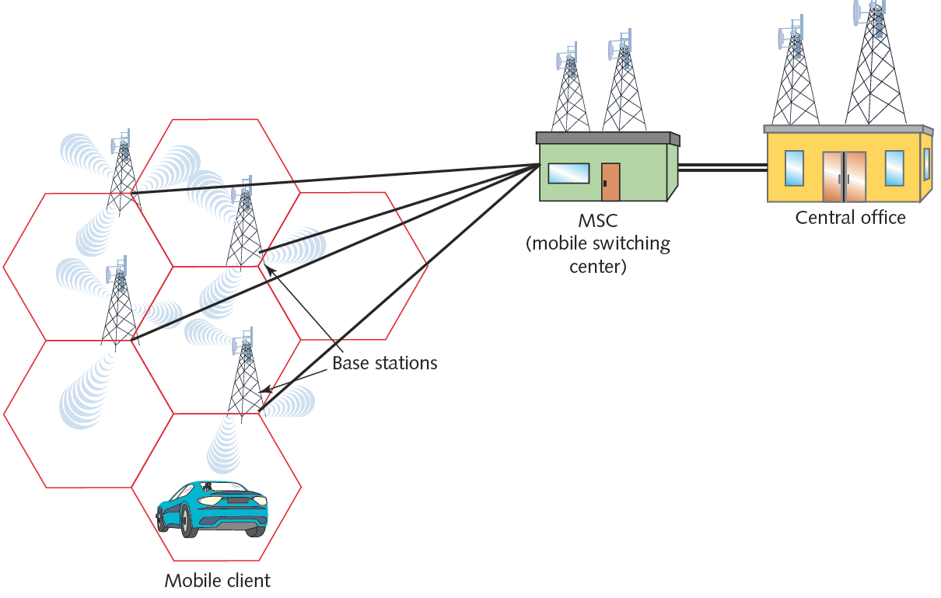
Figure 8-22 Cellular network
Courtesy Course Technology/Cengage Learning

Slide 65
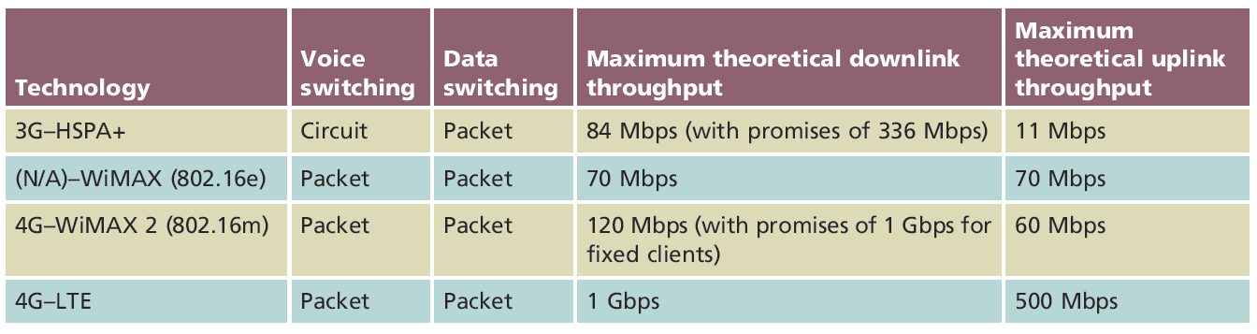
Cellular (cont’d.)
Basic infrastructure
HSPA+ (High Speed Packet Access Plus)
3G technology
LTE (Long Term Evolution)
4G technology
Table 8-2 Characteristics of some wireless WAN services
Courtesy Course Technology/Cengage Learning

Slide 66
Satellite
Used to deliver:
Digital television and radio signals
Voice and video signals
Cellular and paging signals
Data services to mobile clients in remote locations
Most popular satellite orbit
Geosynchronous Earth orbit (GEO)
Satellites orbit at same rate Earth turns

Slide 67
Satellite (cont’d.)
Downlink
Satellite transponder transmits signal to Earth-based receiver
Typical satellite
24 to 32 transponders
Unique downlink frequencies

Slide 68
Satellite (cont’d.)
Satellite frequency bands
L-band—1.5–2.7 GHz
S-band—2.7–3.5 GHz
C-band—3.4–6.7 GHz
Ku-band—12–18 GHz
Ka-band—18–40 GHz
Within bands
Uplink, downlink transmissions differ

Slide 69
Satellite (cont’d.)
Satellite Internet services
Subscriber uses small satellite dish antenna, receiver
Exchanges signals with provider’s satellite network
Typically asymmetrical
Bandwidth shared among many subscribers
Throughput controlled by service provider
Slower, more latency than other wireless WAN options

Slide 70
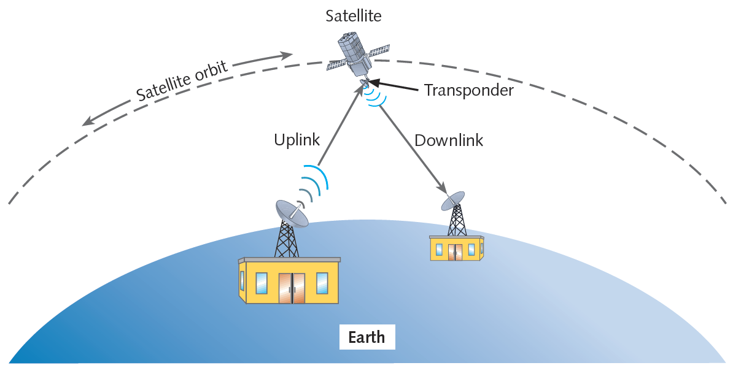
Figure 8-23 Satellite communication
Courtesy Course Technology/Cengage Learning

Slide 71
Summary
Wireless spectrum used for data and voice communications
Each type of service associated with specific frequency band
Wireless communication: fixed or mobile
Standards vary by frequency, signal method, and range
Notable wireless standards include 802.11 a/b/g/n
WiMAX 2: specified in IEEE’s 802.16m standard
Satellites can provide wireless data services

